Slide 1
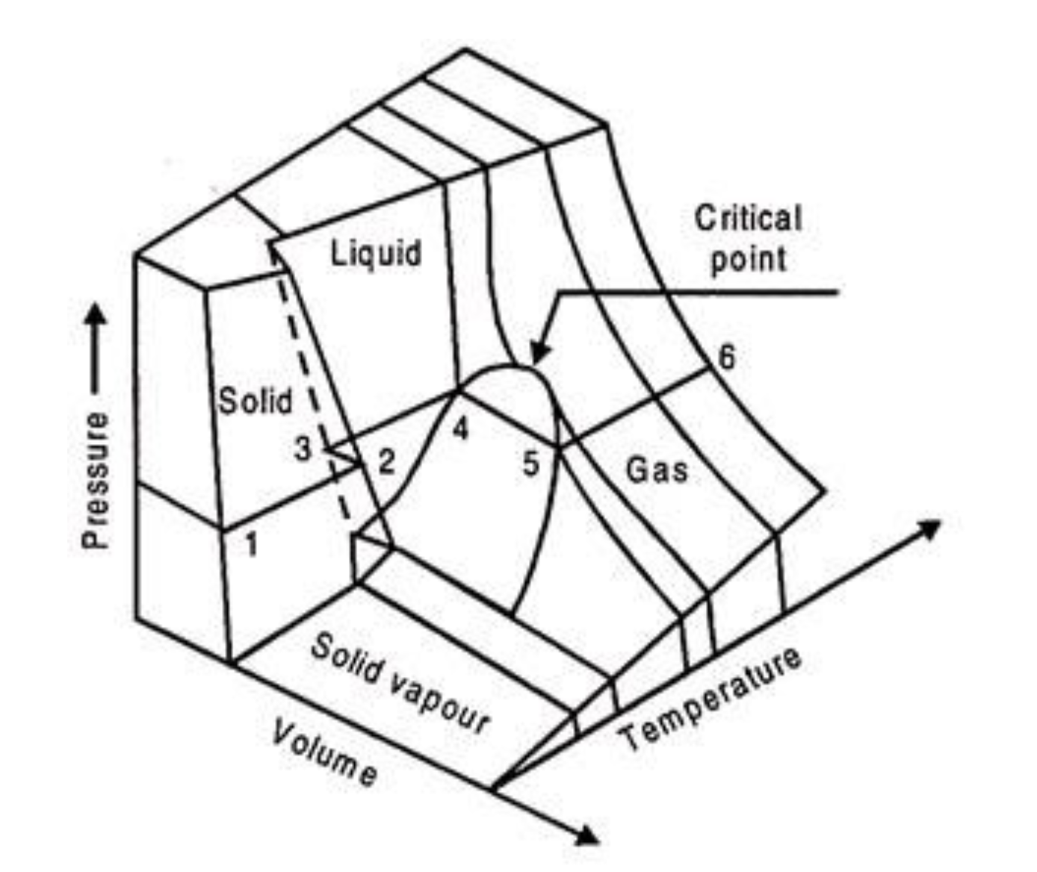
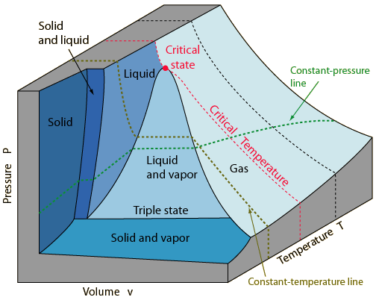
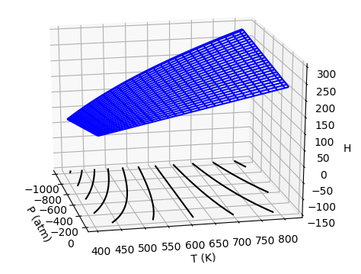
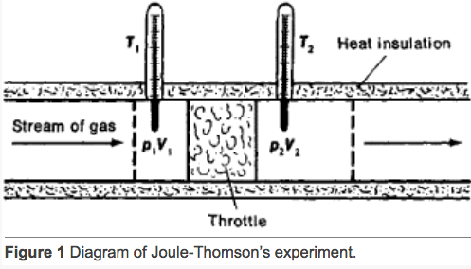


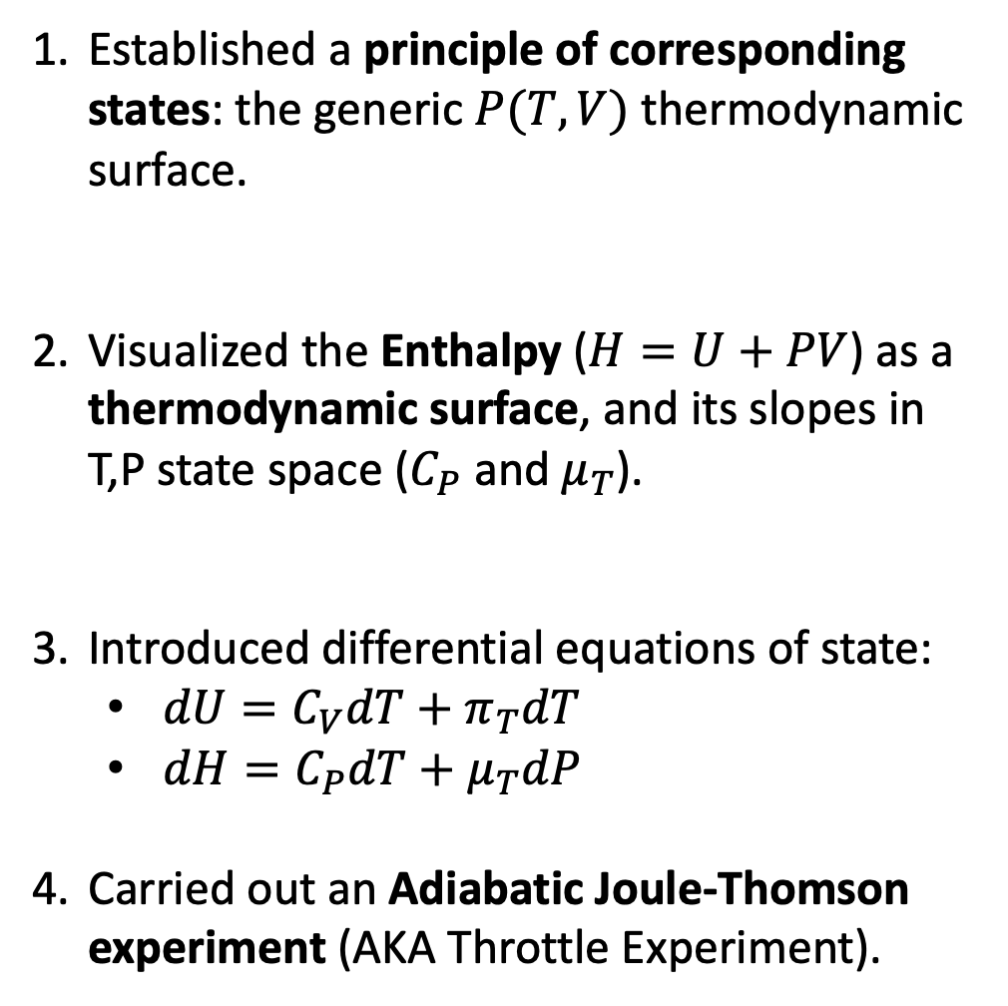

What we’ve done this week
Established a principle of corresponding states: the generic $P(T,V)$ thermodynamic surface.
Visualized the Enthalpy ($H=U+PV$) as a thermodynamic surface, and its slopes in T,P state space ($C_{P}$ and $μ_{T}$).
Introduced differential equations of state:
$dU=C_{V}dT+π_{T}dT$
$dH=C_{P}dT+μ_{T}dP$
Carried out an Adiabatic Joule-Thomson experiment (AKA Throttle Experiment).
$$T_{inv}$$
$$T_{Boyle}$$
$$T_{Crit}$$

Slide 2
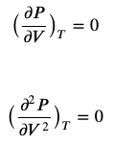




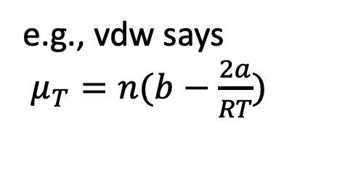


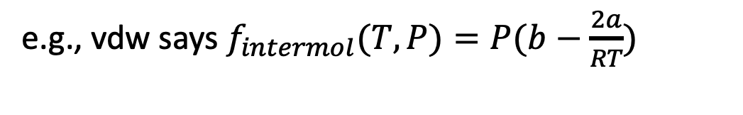
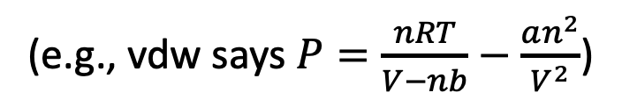
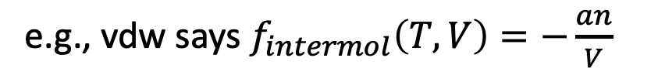

Roadmap of theory and CGIs
(e.g., vdw says $P=\frac{nRT}{V−nb}−\frac{an^{2}}{V^{2}}$)
(AnalyticalTcrit)
$P=P(T,V)$
$T_{crit}$, $V_{crit}$
(AnalyticalMu)
e.g., vdw says
$π_{T}=\frac{an^{2}}{V^{2}}$
e.g., vdw says
$μ_{T}=n(b−\frac{2a}{RT})$
Math
181
Math
180
(AnalyticalH)
Math
181
Math
180
e.g., vdw says $f_{intermol}\left(T,V\right)=−\frac{an}{V}$
e.g., vdw says $f_{intermol}(T,P)=P(b−\frac{2a}{RT})$
(VisualizingH)

Slide 3
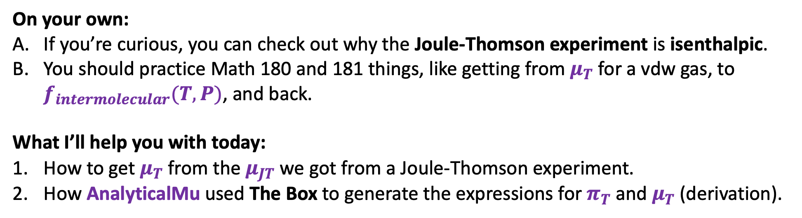
Remaining tasks
On your own:
If you’re curious, you can check out why the Joule-Thomson experiment is isenthalpic.
You should practice Math 180 and 181 things, like getting from $μ_{T}$ for a vdw gas, to $f_{intermolecular}(T,P)$, and back.
What I’ll help you with today:
How to get $μ_{T}$ from the $μ_{JT}$ we got from a Joule-Thomson experiment.
How AnalyticalMu used The Box to generate the expressions for $π_{T}$ and $μ_{T}$ (derivation).

Slide 4

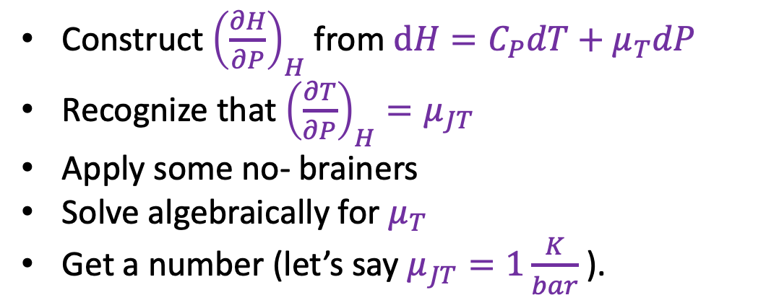
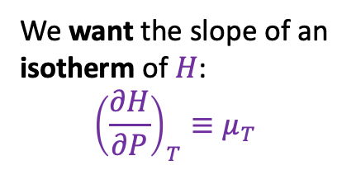

1. How to get $μ_{T}$ from $μ_{JT}$?
We want the slope of an isotherm of $H$:
$${\left(\frac{∂H}{∂P}\right)}_{T}≡μ_{T}$$
Construct ${\left(\frac{∂H}{∂P}\right)}_{H}$ from $dH=C_{P}dT+$ $μ_{T}dP$
Recognize that ${\left(\frac{∂T}{∂P}\right)}_{H}=μ_{JT}$
Apply some no- brainers
Solve algebraically for $μ_{T}$
Get a number (let’s say $μ_{JT}=1\frac{K}{bar}$ ).
We measured the slope of an isenthalp
$${\left(\frac{∂T}{∂P}\right)}_{H}≡μ_{JT}$$

Slide 5
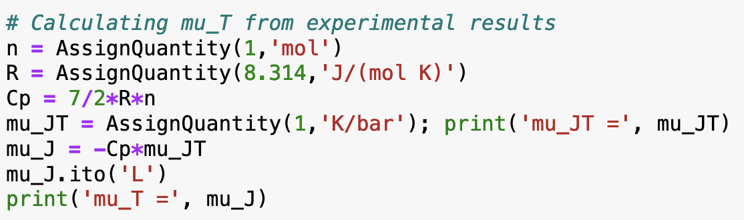

1. How to get $μ_{T}$ from $μ_{JT}$?
We want the slope of an isotherm of $H$:
$${\left(\frac{∂H}{∂P}\right)}_{T}≡μ_{T}$$
Construct ${\left(\frac{∂H}{∂P}\right)}_{H}$ from $dH=C_{P}dT+$ $μ_{T}dP$
Recognize that ${\left(\frac{∂T}{∂P}\right)}_{H}=μ_{JT}$
Apply some no- brainers
Solve algebraically for $μ_{T}$
Get a number (let’s say $μ_{JT}=1\frac{K}{bar}$ ).
We measured the slope of an isenthalp
$${\left(\frac{∂T}{∂P}\right)}_{H}≡μ_{JT}$$

Slide 6
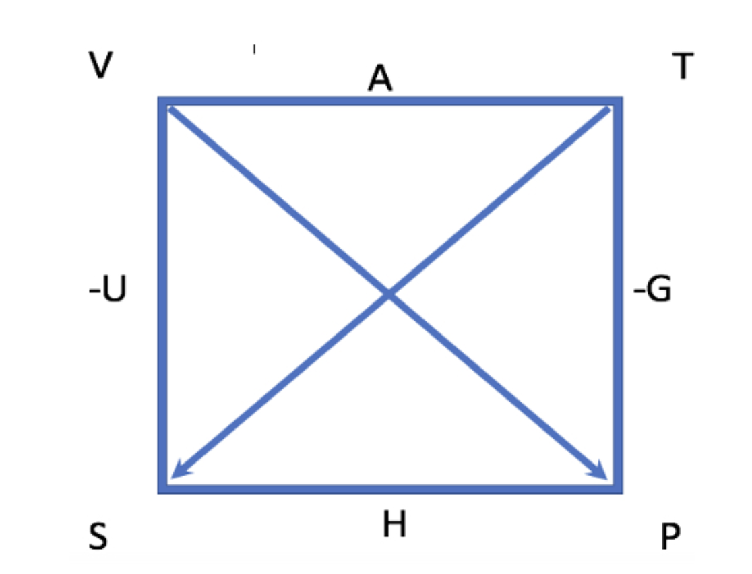
2. How AnalyticalMu used The Box to generate the expressions for $π_{T}$ and $μ_{T}$ (derivation)
?

Slide 7
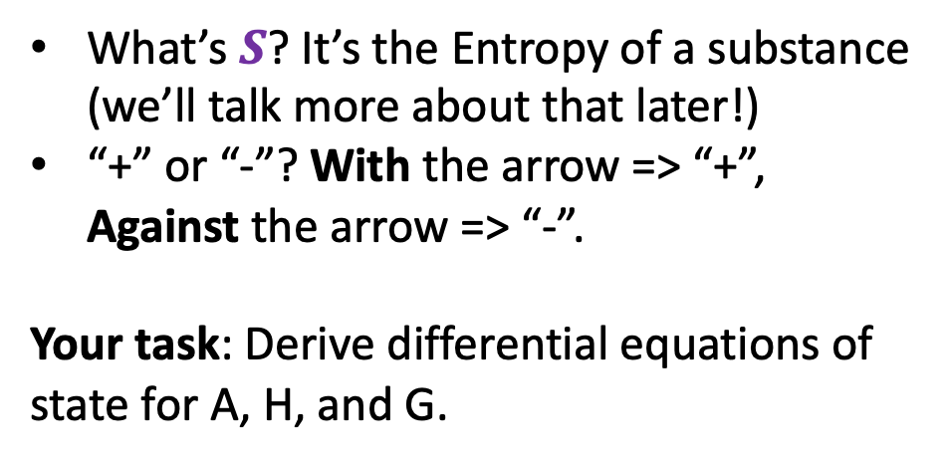
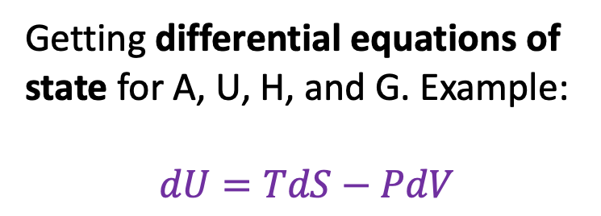
2. How AnalyticalMu used The Box to generate the expressions for $π_{T}$ and $μ_{T}$ (derivation)
What’s $S$? It’s the Entropy of a substance (we’ll talk more about that later!)
“+” or “-”? With the arrow => “+”, Against the arrow => “-”.
Your task: Derive differential equations of state for A, H, and G.
Getting differential equations of state for A, U, H, and G. Example:
$$dU=TdS−PdV$$

Slide 8
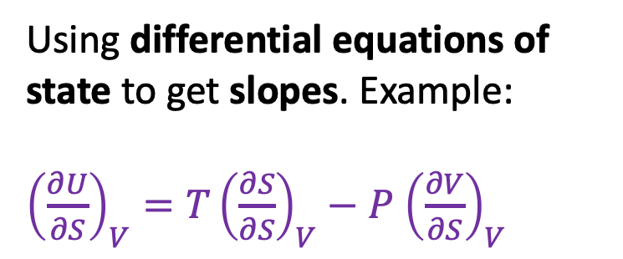
2. How AnalyticalMu used The Box to generate the expressions for $π_{T}$ and $μ_{T}$ (derivation)
Using differential equations of state to get slopes. Example:
${\left(\frac{∂U}{∂S}\right)}_{V}=T{\left(\frac{∂S}{∂S}\right)}_{V}−P$ ${\left(\frac{∂V}{∂S}\right)}_{V}$
Some of these terms can be identified as no-brainers.

Slide 9
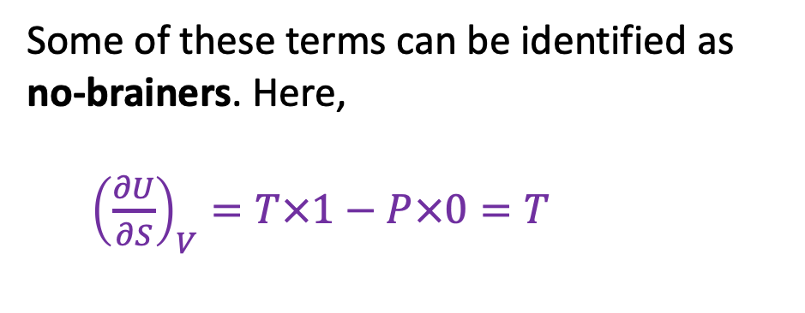
2. How AnalyticalMu used The Box to generate the expressions for $π_{T}$ and $μ_{T}$ (derivation)
Using differential equations of state to get slopes. Example:
${\left(\frac{∂U}{∂S}\right)}_{V}=T{\left(\frac{∂S}{∂S}\right)}_{V}−P$ ${\left(\frac{∂V}{∂S}\right)}_{V}$
Some of these terms can be identified as no-brainers. Here,
${\left(\frac{∂U}{∂S}\right)}_{V}=T×1−P×0=T$

Slide 10
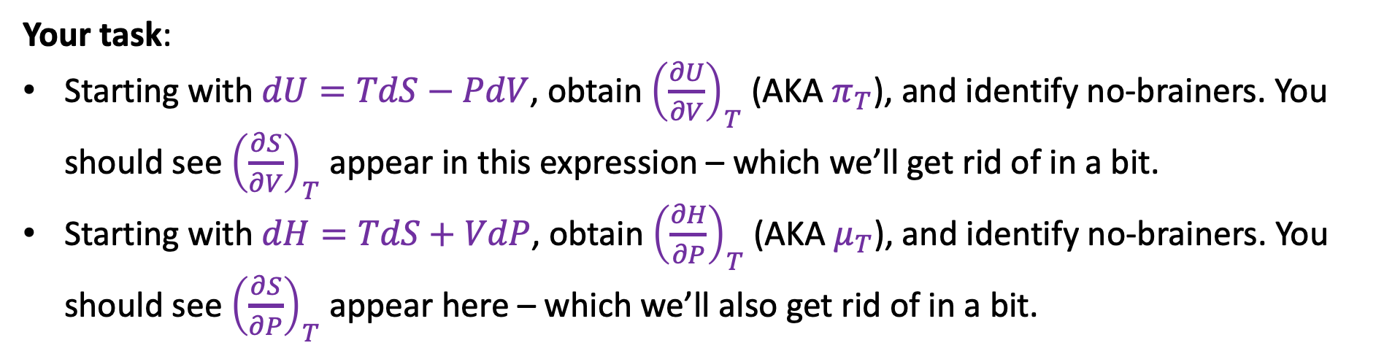
2. How AnalyticalMu used The Box to generate the expressions for $π_{T}$ and $μ_{T}$ (derivation)
Your task:
Starting with $dU=TdS−PdV$, obtain ${\left(\frac{∂U}{∂V}\right)}_{T}$ (AKA $π_{T}$), and identify no-brainers. You should see ${\left(\frac{∂S}{∂V}\right)}_{T}$ appear in this expression – which we’ll get rid of in a bit.
Starting with $dH=TdS+VdP$, obtain ${\left(\frac{∂H}{∂P}\right)}_{T}$ (AKA $μ_{T}$), and identify no-brainers. You should see ${\left(\frac{∂S}{∂P}\right)}_{T}$ appear here – which we’ll also get rid of in a bit.

Slide 11
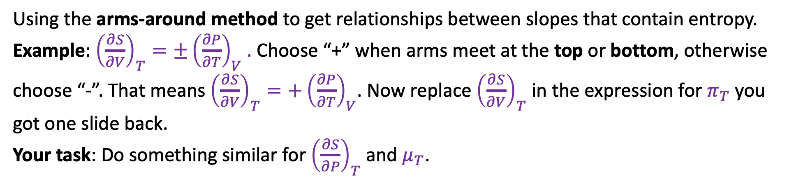
2. How AnalyticalMu used The Box to generate the expressions for $π_{T}$ and $μ_{T}$ (derivation)
Using the arms-around method to get relationships between slopes that contain entropy. Example: ${\left(\frac{∂S}{∂V}\right)}_{T}={±\left(\frac{∂P}{∂T}\right)}_{V}$ . Choose “+” when arms meet at the top or bottom, otherwise choose “-”. That means ${\left(\frac{∂S}{∂V}\right)}_{T}={+\left(\frac{∂P}{∂T}\right)}_{V}$. Now replace ${\left(\frac{∂S}{∂V}\right)}_{T}$ in the expression for $π_{T}$ you got one slide back.
Your task: Do something similar for ${\left(\frac{∂S}{∂P}\right)}_{T}$ and $μ_{T}$.

Slide 12
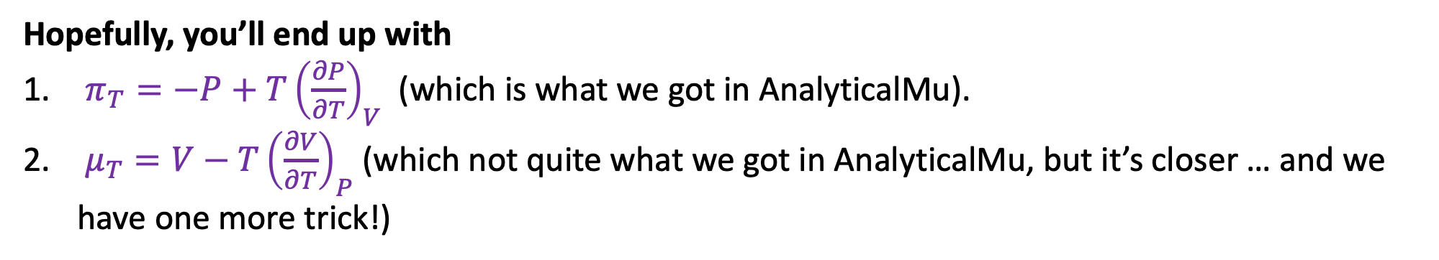
2. How AnalyticalMu used The Box to generate the expressions for $π_{T}$ and $μ_{T}$ (derivation)
Hopefully, you’ll end up with
$π_{T}={−P+T\left(\frac{∂P}{∂T}\right)}_{V}$ (which is what we got in AnalyticalMu).
$μ_{T}={V−T\left(\frac{∂V}{∂T}\right)}_{P}$ (which not quite what we got in AnalyticalMu, but it’s closer … and we have one more trick!)

